Slide 1

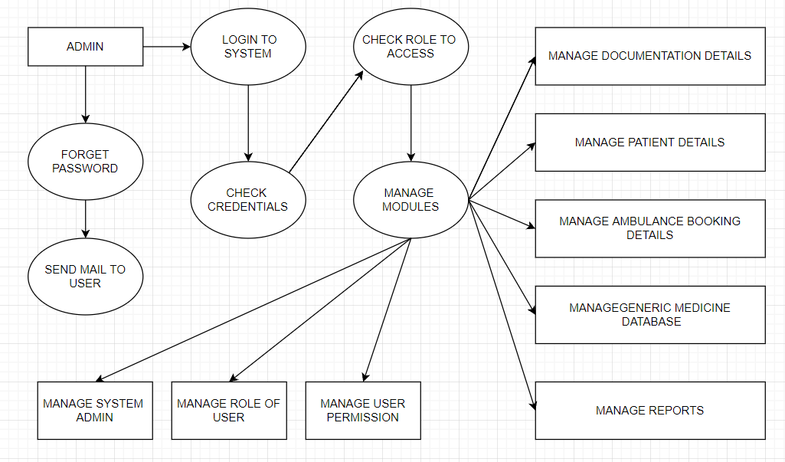
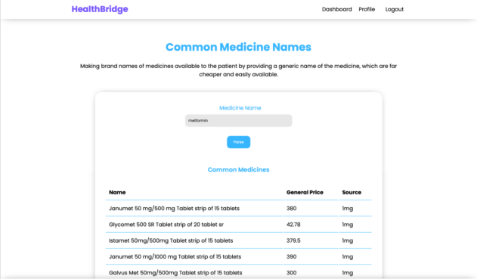
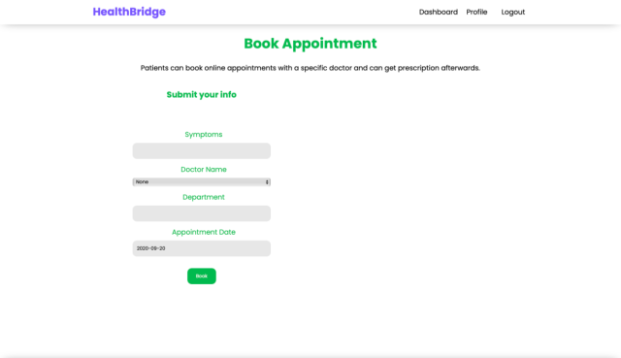
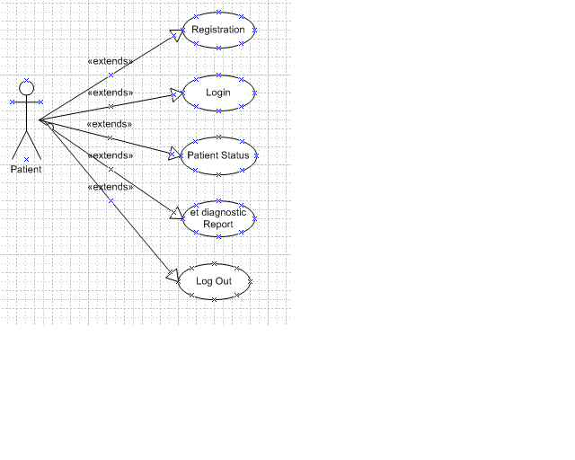
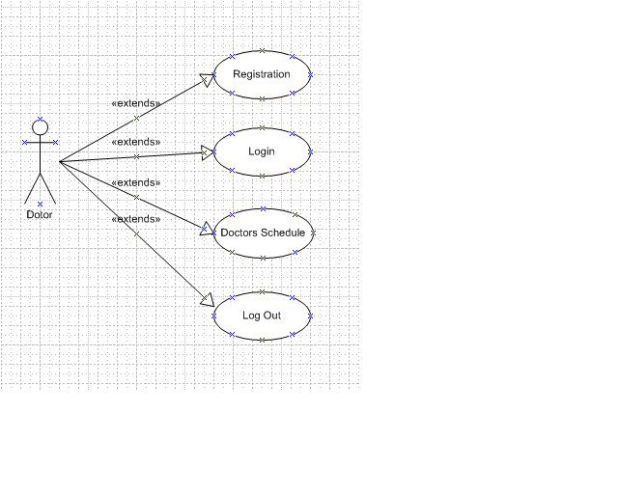
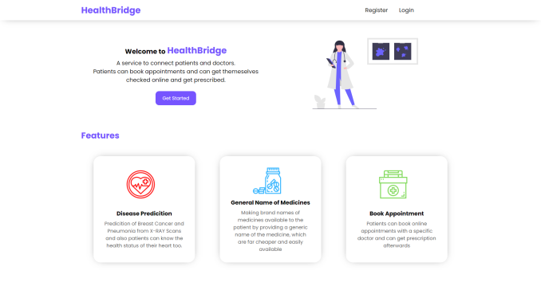
HEALTH-BRIDGE WEBSITE Ritik V Jaiswal, Harsh Sawant, Shubham Bagwe, Esha Thakur
Department of Information Technology
BE Project Poster Academic Year 2021-22
Abstract The aim of Project HealthBridge is to make the interaction of patients and doctors seamless, convenient and more organized. This platform is built keeping in mind the problems and hassles one has to face while using any medical facility via hospitals. Here's what we provide for patients: a. Doctor appointment booking b. Lab test booking c. Online prescription & medical history database d.Generic drugs to brand name converter & recommendation system e. Ambulance on demand service f. Disease prediction services For doctors, we provide the following services: a. Appointment management system b. Online prescription creation system c. View medical history and previous appointments of patient d. Prioritized lab results for disease infected patients 2. Introduction/Theory Doctors giving prescriptions to patient it’s a common matter, but our proposed system is different from common aspects. Doctor will suggest generic names of medicines and the patient will get the prescription list by patient id. From the list it will show the current medicine type with price. We hope that will be effective for the medical report system, patients can get medicine by their own choice. A service to connect patients and doctors. Patients can book appointments and can get themselves checked online and get prescribed. We also inbuilt features such as : a-Disease Prediction: Prediction of Breast Cancer Pneumonia from X-Ray Scans also patients can know the health status of the heart too. b-General Names and Medicines: Making brand names and medicines available to the patients by providing them a generic name of the medicines. Which are far cheaper and easily available . c-Book Appointment:Patients can book and appointment with a specific doctor and can get prescribed afterwards. 3. Problem Statement The health problem is the gap between an acceptable or desirable health status and the current status. At least half of the world’s population cannot obtain essential health services, according to a new report from the World Bank and WHO. And each year, large numbers of households are being pushed into poverty because they must pay for health care out of their own pockets. The main high-level sessions of the Forum take place tomorrow, Dec. 14, and will also feature an all-day “innovation showcase,” highlighting innovations driving progress in health systems around the world, and a celebratory public event in the evening. A commitment to action, called the Tokyo Declaration on Universal Health Coverage, will be released during the Forum’s closing ceremony. Our objective is to provide proper health care with re required prescription which makes it easy to provide the required assistance to the people below poverty line . It provides them will the generic medicines which helps to save money at the same time as they are getting treated
4. Implementation Architecture patient side Doctor side 5. Results Home page
Prescribed medicines (Search list): Book Appoinment page 6. Conclusion Generic medicine gets a unanimous thumbs-up! This application will give the new proposed system of prescription. Generic medicine is just an alternative that patients can use for branded medicines. Everyone needs to be well informed and concerned about the quality of care. Everyone means patients and their families, consumer agents and advocates, health professionals, administrators of health plans and facilities, purchasers of healthcare services, and policymakers at all levels. 7.Future Scope This project is basically updating the manual chemist inventory system to an automated inventory system so that organizations can manage their records in an efficient and organized form References [1] R Development Core Team, “A Language and Environment for Statistical Computing,” Vienna, Austria, ISBN 3-900051-07-0. [2] Hipp, R, et. al. (2015). SQLite (Version 3.8.10.2) [Computer software]. SQLite Development Team. Retrieved June 15, 2015. [3] David Flangan ,”JavaScript: The Defintive Guide “,3rd O'Reilly & Associates, Inc. Sebastopol, CA, USA ©1998 ISBN:1565923928

